Slide 1
CEGE0096: Geospatial Programming
Lecture 5: Geometry with Python
Dr. Aldo Lipani

Slide 2
Exercise 7 (30 Minutes)
Design an object-oriented program for the following classes:
Geometry, Point, Line, Polygon, Triangle and Square.
This program should allow the construction of:
A point;
A line given two points;
A polygon given 3 or more points;
A triangle given 3 points;
A square given its bottom left point and its side length.
These classes should implement the methods to get or compute (where and when appropriate): the name, the x, the y, the lines, and the area.
TIP: use the Shoelace Formula to compute the area of a triangle given 3 points.
Notes:
1

Slide 3
Solution
class Geometry: def __init__(self, name): self.__name = name def get_name(self): return self.__name class Point(Geometry): def __init__(self, name, x, y): super().__init__(name) self.__x = x self.__y = y def get_x(self): return self.__x def get_y(self): return self.__y
Notes:
2

Slide 4
Solution (II)
class Line(Geometry): def __init__(self, name, point_1, point_2): super().__init__(name) self.__point_1 = point_1 self.__point_2 = point_2 class Polygon(Geometry): def __init__(self, name, points): super().__init__(name) self.__points = points def get_points(self): return self.__points def lines(self): res = [] points = self.get_points() point_a = points[0] for point_b in points[1:]: res.append(Line(point_a.get_name() + '-' + point_b.get_name(), point_a, point_b)) point_a = point_b res.append(Line(point_a.get_name() + '-' + points[0].get_name(), point_a, points[0])) return res
Notes:
3

Slide 5
Solution (III)
class Triangle(Polygon): def __init__(self, name, point_1, point_2, point_3): super().__init__(name, [point_1, point_2, point_3]) def area(self): res = 0 ps = self.get_points() # Shoelace Formula res = res + ps[1].get_x() * ps[2].get_y() - ps[2].get_x() * ps[1].get_y() res = res - ps[0].get_x() * ps[2].get_y() + ps[2].get_x() * ps[0].get_y() res = res + ps[0].get_x() * ps[1].get_y() - ps[1].get_x() * ps[0].get_y() res = abs(res) / 2 return res
Notes:
4

Slide 6
Solution (IV)
class Square(Polygon): def __init__(self, name, bl_point, side): points = [bl_point, Point('top left point', bl_point.get_x(), bl_point.get_y() + side), Point('top right point', bl_point.get_x() + side, bl_point.get_y() + side), Point('bottom right point', bl_point.get_x() + side, bl_point.get_y())] super().__init__(name, points) self.__side = side def area(self): return self.__side ** 2
Notes:
5

Slide 7
Solution (V)
point_a = Point('A', 0, 0) point_b = Point('B', 0, 1) point_c = Point('C', 1, 1) triangle = Triangle('A', point_a, point_b, point_c) print('Lines of the triangle ' + triangle.get_name() + ':') for line in triangle.lines(): print(line.get_name()) print('Area:', triangle.area())
Notes:
6

Slide 8
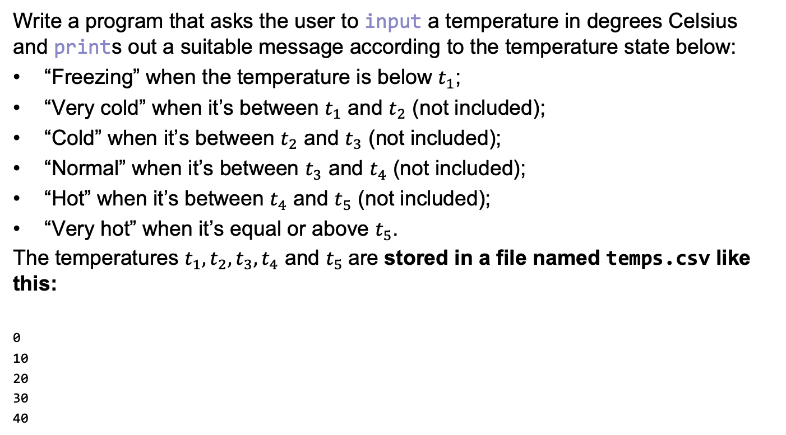
Exercise 8 (10 Minutes)
Write a program that asks the user to input a temperature in degrees Celsius and prints out a suitable message according to the temperature state below:
“Freezing” when the temperature is below $t_{1}$;
“Very cold” when it’s between $t_{1}$ and $t_{2}$ (not included);
“Cold” when it’s between $t_{2}$ and $t_{3}$ (not included);
“Normal” when it’s between $t_{3}$ and $t_{4}$ (not included);
“Hot” when it’s between $t_{4}$ and $t_{5}$ (not included);
“Very hot” when it’s equal or above $t_{5}$.
The temperatures $t_{1}, t_{2},t_{3},t_{4}$ and $t_{5}$are stored in a file named temps.csv like this:
0
10
20
30
40
Notes:
7

Slide 9
Solution
print('Temperature to Perceived Temperature Converter (0.4)') perceived_temps = ['freezing', 'very cold', 'cold', 'normal', 'hot', 'very hot'] temps = [] with open('temps.csv', 'r') as f: for line in f.readlines(): temp = float(line) temps.append(temp) temp = float(input('What temperature is outside? ')) perceived_temp = perceived_temps[-1] for i in range(len(temps)): if temp < temps[i]: perceived_temp = perceived_temps[i] break print('Your temperature today is', perceived_temp)
Notes:
8

Slide 10
Writing a Program

Slide 11
Modeling and Representation
To write a program, first write down a short description of what you want the program to do.
For your coursework, this is more or less the text of the assignment.
The next step is to ask yourself the following questions:
Who is going to use this program?
How many times will it be used?
Will it be extended in the future?

Slide 12
Input Data
What data do I have access to?
What file format is it in?
What is the best way for my program to access the data?
Hard coding;
From a file;
From a database;
From the web;
Using a Graphical Unit Interface (GUI);
Keyboard input;
Etc.

Slide 13
Storing the Data in the Program
When do I want to read the data?
As required?
At the start of the program?
Having read the data, what is the best way to represent it within my program?
String;
List;
Set;
Dictionary;
Custom Data Structure.

Slide 14
Output Data
What is the best way to report my output?
To screen
In the command prompt
In a GUI
To a file
To a database
To a webpage
To an email
Etc.

Slide 15
Developing the Program in Pseudocode
Rewrite the problem statement as a logical sequence:
# Read price data from file into a list # Read the first item of the list # If price of item is greater than 100 pounds then add item to list of expensive items # Repeat with the next item on the list # Convert the list of items into a string with a newline after each item # Save the string to a file

Slide 16
Review the Pseudocode
Review the logical sequence:
Identify flow control:
While or for best?
If/elif/else?
Define a function?
Define a class?
Identify objects, literals and variables
Identify expressions, operators, functions and methods

Slide 17
Review the Pseudocode (II)
Re-write the logical sequence:
# READ price data from file into a list_of_items
# FOR each_item IN the list_of_items
# split each_item string and assign parts to item_name and item_price # IF price of each_item > 100
# THEN add each_item to list_of_expensive_items # string_of_expensive_items = list_of_expensive_items converted to string with new line # SAVE string_of_expensive_items to a file

Slide 18
Rewrite Pseudocode into Python
Re-write the logical sequence:
# READ price data from file into a list_of_items with open('data.csv') as f: list_of_items = f.readlines() list_of_expensive_items = [] # If price of item is greater than 100 pounds then add item to list of expensive items for each_item in list_of_items: item_name, item_price = each_item.split(',') if float(item_price) > 100: list_of_expensive_items .append(item_name.strip()) # Convert the list of items into a string with a newline after each item string_of_expensive_items = "\n".join(list_of_expensive_items) # SAVE string_of_expensive_items to a file with open('expensive_items.csv', 'w') as f: f.write(string_of_expensive_items)

Slide 19
Commenting
A well-written program makes clear to the reader what is happening at each step.
Helpful for:
Other programmers;
Yourself when returning to the code later.
Comments can either be inline or on their own line.
Use your Pseudocode as the basis of your comments.
But do not comment the obvious:
some_test = 'example' # setting some_text # print string some_text print(some_test)

Slide 20
Multiple Files Program
When the program becomes complex, you can divide your program into multiple files. To use functions or classes defined in other files, you can use the keyword import:
import foo
foo.bar()
Or you can import only a part of it:
from foo import bar
bar()
You can also give aliases to these imports:
import foo as f f.bar() from foo import bar as b b()
To successfully import code from another file, you need to fulfil the basic program planning: have a main function.
What happens if you don’t do it?

Slide 21
Basic Program Planning (II)
It is standard practice to turn all code into a main function:
Ensures that there are no stray global variables;
Futureproofs your code should you want to use it into another script.
When import-ing a file, this file gets parsed and executed.

Slide 23
Matplotlib
Matplotlib is one of the most used data visualisation packages in Python.
This is commonly imported as plt.
import matplotlib.pyplot as plt

Slide 24
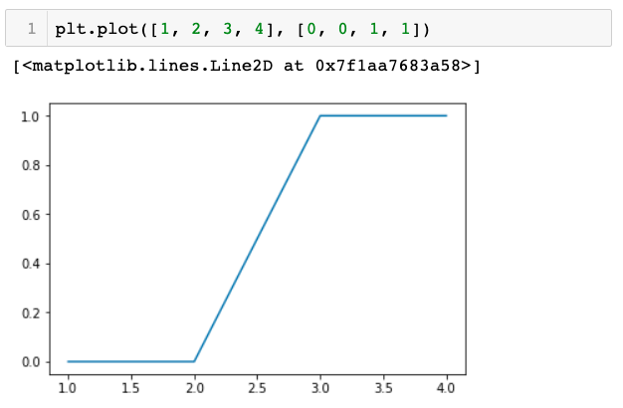
Matplotlib in Jupyter Notebooks
Jupyter notebook has built-in matplotlib support showing plots in the notebook.

Slide 25
Matplotlib in Standalone Programs
When developing standalone programs, you also need to call the show method.
import matplotlib.pyplot as plt if __name__ == '__main__': plt.plot([1, 2, 3, 4], [0, 0, 1, 1]) plt.show()
show opens a window and pauses the program until the window is closed.

Slide 26
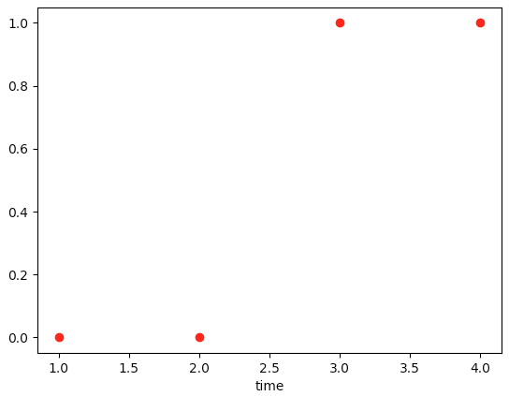
Formatting the Style
With a third argument, you can indicate the colour and the line type of the plot:
plt.plot([1, 2, 3, 4], [0, 0, 1, 1], 'ro')
r stands for red and o for point.
To label the axis you can use:
plt.xlabel('time')
Here you find a complete list of format strings:
https://matplotlib.org/api/_as_gen/matplotlib.pyplot.plot.html#matplotlib.pyplot.plot

Slide 27
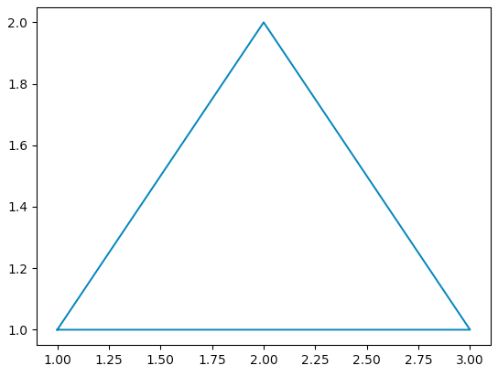
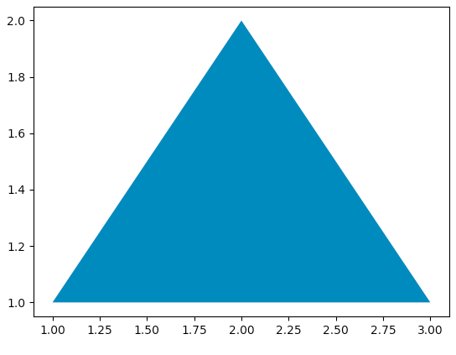
Drawing Shapes
Based on the input of the function, you can draw shapes:
plt.plot([1, 3, 2, 1], [1, 1, 2, 1])
To plot filled shapes, you can use the method fill:
plt.fill([1, 3, 2, 1], [1, 1, 2, 1])

Slide 28
Documentation and Tutorials
For documentation and tutorials about matplotlib, visit:
https://matplotlib.org/index.html
https://matplotlib.org/tutorials/index.html

Slide 29
Point-in-polygon Test

Slide 30
Point-in-Polygon Test

Slide 31
Test Whether a Point is in the Polygon
Given a point and a polygon, the point-in-polygon problem involves determining whether the point lies inside, outside or on the boundary of the polygon.

Slide 32


Minimum Bounding Rectangle
The MBR is defined as the smallest rectangle with sides parallel to the axes of the Cartesian frame.
$$(x_{max},y_{max})$$
$$(x_{min},y_{min})$$

Slide 33
Minimum Bounding Rectangle (II)
If a point is outside the MBR then the point is certainly outside the polygon, otherwise we do not know yet: A more sophisticated algorithm is needed to determine it.
# IF x_min < point.x < x_max AND y_min < point.y < y_max: # THEN point is inside the MBR but we don't know about the polygon # ELSE: # THEN point is outside the MBR

Slide 34
Point-in-Polygon
If the point is inside the MBR then a Point-in-Polygon (PiP) algorithm is needed. The ray casting algorithm (RCA) is an example of a PiP algorithm.

Slide 35
Ray Casting Algorithm
Draw a line from the point to “infinity” (in any direction), then count the number of times the line crosses the polygon boundary. If the number of crossings is even, then the point is outside the polygon, else if the number of crossings is odd the point is inside the polygon.

Slide 36
Ray Casting Algorithm (II)
Pseudocode of the RCA algorithm:
# SET counting to 0 # FOR each line of polygon: # IF ray crosses the line: # THEN INC counting by 1
# IF counting is odd: # THEN the point is inside # ELSE # THEN the point is outside

Slide 37
Ray Casting Algorithm (III)
What point at “infinity” should I use?
Any point outside the MBR would work;
However, if you assume that the point is at infinity, the math simplifies, so actually, you don’t need to define such a point.
We will now review some checks needed to implement the RCA:
Point on a line;
Line crossing another line;
Line crossing with a parallel line to the x-axis;
Special Case for RCA: use this if your rays are parallels to the x-axis.

Slide 38


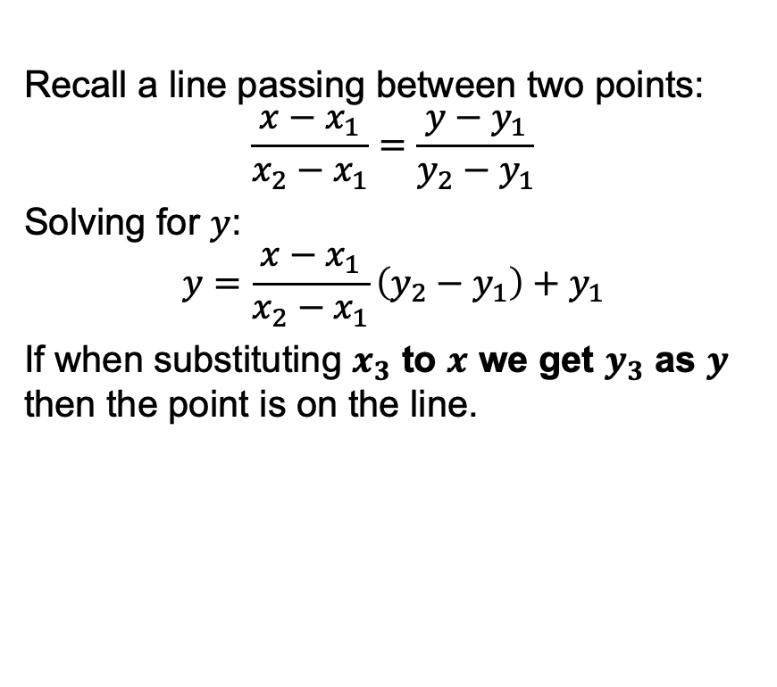



Point on a Line Algorithm
Recall a line passing between two points:
$$\frac{x−x_{1}}{x_{2}−x_{1}}=\frac{y−y_{1}}{y_{2}−y_{1}}$$
Solving for $y$:
$$y=\frac{x−x_{1}}{x_{2}−x_{1}}\left(y_{2}−y_{1}\right)+y_{1}$$
If when substituting $x_{3}$ to $x$ we get $y_{3}$ as $y$ then the point is on the line.
$$y$$
$$(x_{1},y_{1})$$
$$(x_{3},y_{3})$$
$$(x_{2},y_{2})$$
$$x$$

Slide 39


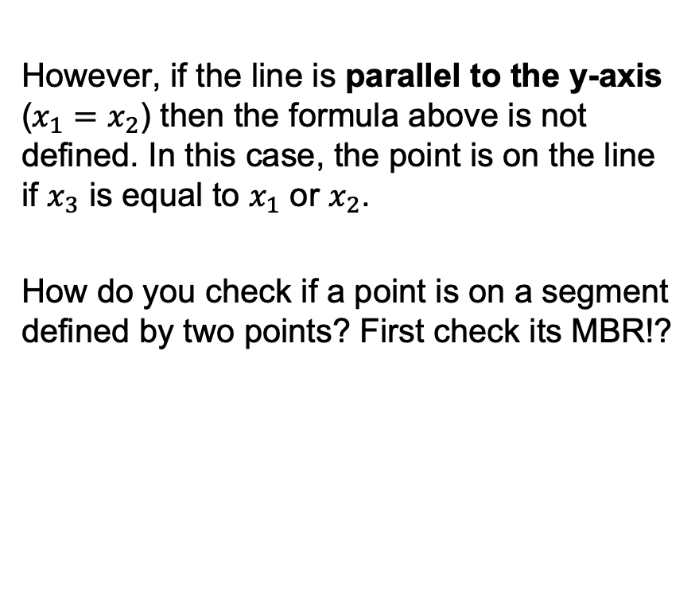



Point on a Line Algorithm (II)
However, if the line is parallel to the y-axis ($x_{1}=x_{2}$) then the formula above is not defined. In this case, the point is on the line if $x_{3}$ is equal to $x_{1}$ or $x_{2}$.
How do you check if a point is on a segment defined by two points? First check its MBR!?
$$y$$
$$(x_{1},y_{1})$$
$$(x_{3},y_{3})$$
$$(x_{2},y_{2})$$
$$x$$

Slide 40
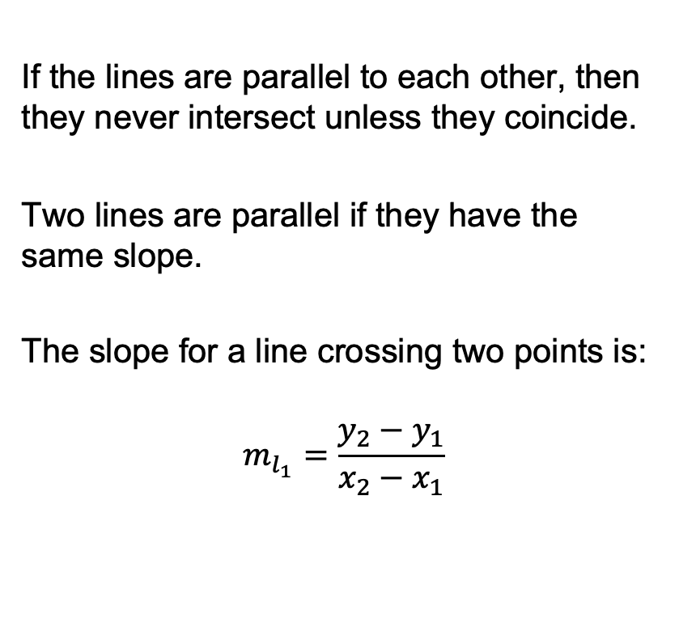




Line Crossing Algorithm
If the lines are parallel to each other, then they never intersect unless they coincide.
Two lines are parallel if they have the same slope.
The slope for a line crossing two points is:
$$m_{l_{1}}=\frac{y_{2}−y_{1}}{x_{2}−x_{1}}$$
$$y$$
$$(x_{4},y_{4})$$
$$l_{2}$$
$$(x_{1},y_{1})$$
$$(x_{2},y_{2})$$
$$l_{1}$$
$$(x_{3},y_{3})$$
$$x$$

Slide 41
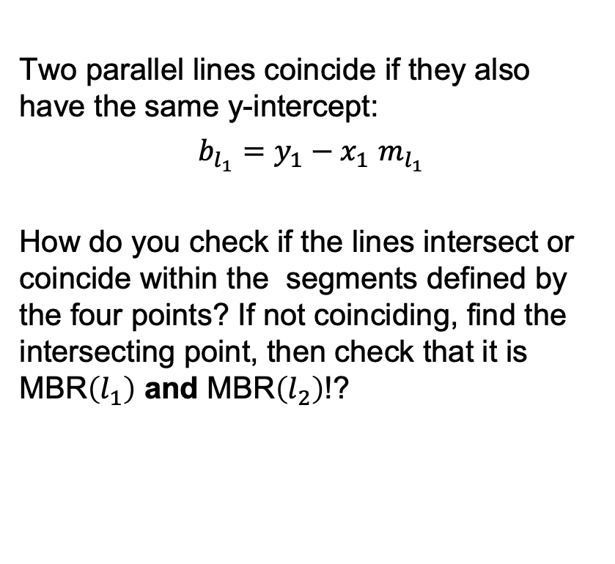




Line Crossing Algorithm (II)
Two parallel lines coincide if they also have the same y-intercept:
$b_{l_{1}}=$ $y_{1}−x_{1}$ $m_{l_{1}}$
How do you check if the lines intersect or coincide within the segments defined by the four points? If not coinciding, find the intersecting point, then check that it is MBR$\left(l_{1}\right)$ and MBR$\left(l_{2}\right)$!?
$$y$$
$$(x_{4},y_{4})$$
$$l_{2}$$
$$(x_{1},y_{1})$$
$$(x_{2},y_{2})$$
$$l_{1}$$
$$(x_{3},y_{3})$$
$$x$$

Slide 42
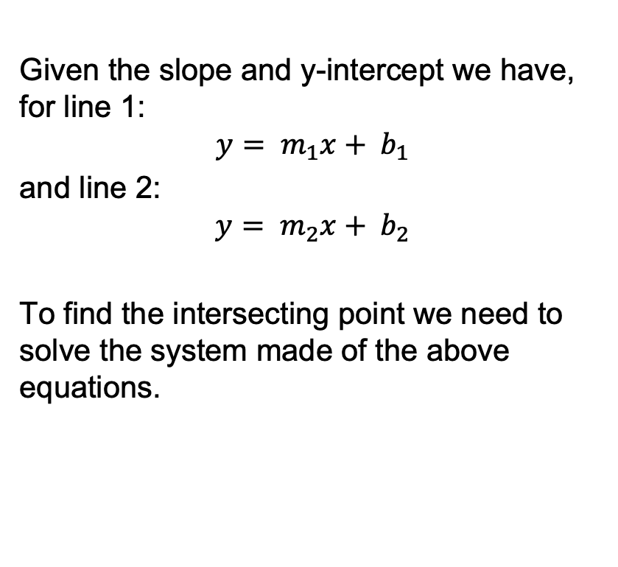
The Intersecting Point
Given the slope and y-intercept we have, for line 1:
$$y= m_{1}x+ b_{1}$$
and line 2:
$$y= m_{2}x+ b_{2}$$
To find the intersecting point we need to solve the system made of the above equations.
$$y$$
$$(x_{4},y_{4})$$
$$l_{2}$$
$$(x_{1},y_{1})$$
$$(x_{2},y_{2})$$
$$l_{1}$$
$$(x_{3},y_{3})$$
$$x$$

Slide 43







The Intersecting Point (II)
If you have done the appropriate checks as suggested in the previous slides, this system has always a solution:
$$x=\frac{b_{2}−b_{1}}{m_{1}−m_{2}}, y=\frac{b_{2}m_{1}−b_{1}m_{2}}{m_{1}−m_{2}}$$
How do you check that this point intersects with the segments defined by the four points? If not coinciding, find the intersecting point, then check that it is MBR$\left(l_{1}\right)$ and MBR$\left(l_{2}\right)$!?
$$y$$
$$(x_{4},y_{4})$$
$$l_{2}$$
$$(x_{1},y_{1})$$
$$(x_{2},y_{2})$$
$$l_{1}$$
$$(x_{3},y_{3})$$
$$x$$

Slide 44




Intersecting Point (Special Case)
If you have done the appropriate checks as suggested in the previous slides, this system has always a solution:
$$x=\frac{b_{2}−y_{1}}{m_{2}}, y=y_{1}$$
How do you check that this point intersects within the semi-line defined by the points of line 1 and the segment defined by the points of line 2?
$$y$$
$$(x_{4},y_{4})$$
$$l_{2}$$
$$(x_{1},y_{1})$$
$$(+∞,y_{1})$$
$$l_{1}$$
$$(x_{3},y_{3})$$
$$x$$

Slide 45
RCA Special Cases
Boundary points: Easy, just check if a point lies on a line of the polygon.
Points crossing vertices of the polygon: More difficult, it requires some additional considerations.

Slide 46





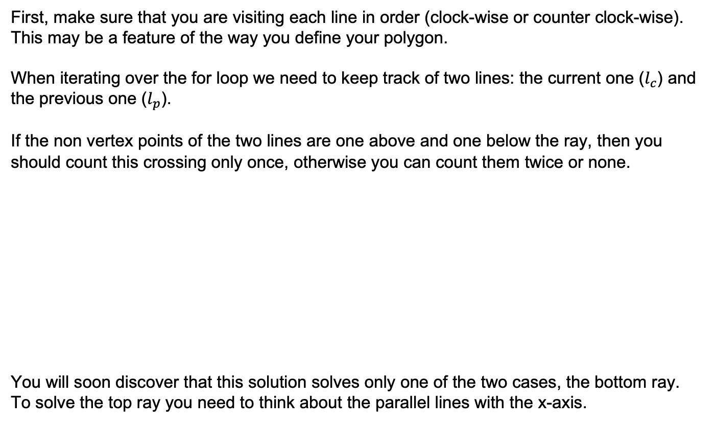









Point Crossing Vertices
First, make sure that you are visiting each line in order (clock-wise or counter clock-wise). This may be a feature of the way you define your polygon.
When iterating over the for loop we need to keep track of two lines: the current one ($l_{c}$) and the previous one ($l_{p}$).
If the non vertex points of the two lines are one above and one below the ray, then you should count this crossing only once, otherwise you can count them twice or none.
You will soon discover that this solution solves only one of the two cases, the bottom ray. To solve the top ray you need to think about the parallel lines with the x-axis.
Count Once
Count Twice or None
$$(x_{2},y_{2})$$
$$(x_{2},y_{2})$$
$$({x′}_{1},{y′}_{1})$$
$$l_{c}$$
$$l_{c}$$
$$l_{p}$$
$$(x_{1},y_{1})$$
$$(+∞,y_{1})$$
$$(x_{1},y_{1})$$
$$(+∞,y_{1})$$
$$({x′}_{2},{y′}_{2})$$
$$({x′}_{2},{y′}_{2})$$
$$l_{p}$$
$$({x′}_{1},{y′}_{1})$$

Slide 47
1st Assignment

Slide 48
Point-in-Polygon Test
You need to build on the Geometry, Point, Line, and Polygon classes that you have created.
Your task is to write two Python programs:
main_from_file.py and main_from_user.py
main_from_file.py should:
Read a list of coordinates from a CSV file and create a polygon;
Read a list of coordinates from a file and create a list of testing points;
Categorize these points into: “inside”, “outside” and “boundary”;
Output the result of each point in a CSV file;
Plot the points and polygon in a plot window.

Slide 49
main_from_file.py
from plotter import Plotter def main(): plotter = Plotter() print('read polygon.csv') print('read input.csv') print('categorize points') print('write output.csv') print('plot polygon and points') plotter.show() if __name__ == '__main__': main()

Slide 50
Point-in-Polygon Test (II)
main_from_user.py should:
Read a list of coordinates from a CSV file and create a polygon;
Read a point from keyboard;
Categorize this point into “inside”, “outside” and “boundary”;
Plot the point and polygon in a plot window.

Slide 51
main_from_user.py
from plotter import Plotter def main(): plotter = Plotter() print('read polygon.csv') print('Insert point information') x = float(input('x coordinate: ')) y = float(input('y coordinate: ')) print('categorize point') print('plot polygon and point') plotter.show() if __name__ == '__main__': main()

Slide 52
Input
Reading the CSV file. Create a function or method that takes a CSV file and creates a list of points. This may be reused also to read the list of testing points.
You can get more marks if you can pass the file path as an argument to the main function.
Input a Point for testing. Ask the user to input the coordinates from the keyboard.
You can get more marks if you can pass a tuple pairs as an argument to a main function.

Slide 53
Output
Writing the CSV file. Create a function or method that takes a file name and creates a CSV containing the id of each point and its categorization.
You can get more marks if you can pass the output file name as an argument to the main function.
A sample CSV called ‘sample_output.csv’ is provided.

Slide 54
Provided Material
Data (provided together with the project template):
1 CSV file containing the coordinates of a polygon;
1 CSV file of testing point;
1 CSV file containing a sample output.
Project template:
Predefined main functions;
Plotter class already defined.
Project report:
https://docs.google.com/document/d/1hwSchzGKcCURs5tO8r3OFI5h_FokUDd6y9ryttIZfHk

Slide 55
Submission
This assignment should be submitted as follows:
a zip file containing the project solution to the Assessment tab of the module Moodle page;
a pdf file of the project report to the Assessment tab of the module Moodle page;
as a GitHub repository.
Failing to carefully follow these instructions may result in penalties.
Note that an element of collaborative work is allowed in this project but
please do not submit scripts that are identical to one another. In this case your work will not be accepted.

Slide 56
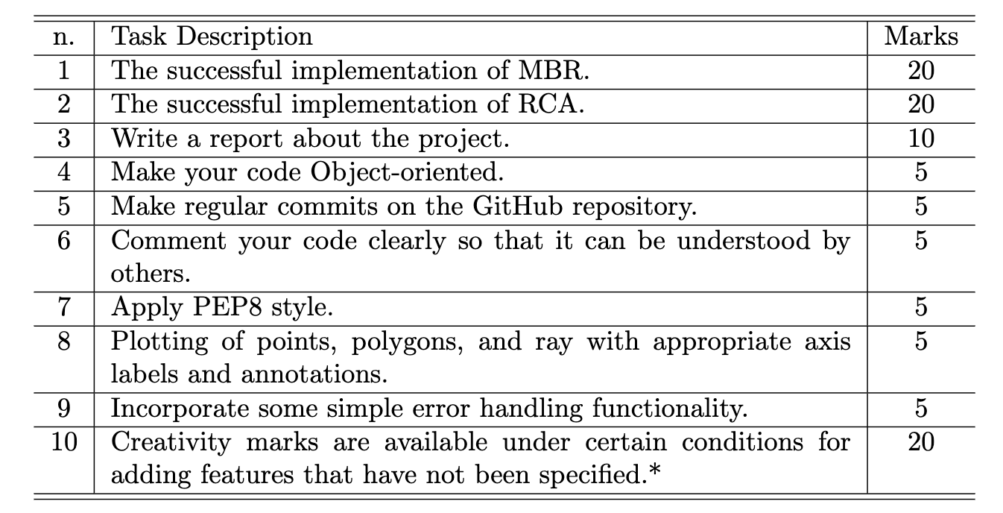
Marking Scheme
*The creativity marks will be considered only if you have scored more than zero on all the other tasks

Slide 57
Violations
Any of the following is not allowed, their violation will result in penalties:
• The use of any Python module (e.g., csv, numpy, etc.); • Screenshots of your code pasted in your report. Please copy and paste your code as text; • Copying code from other sources without referencing; • Plagiarising is severely punished. Please read the assessment tab in Moodle for more details about it; • Copying your classmate report or code is also considered plagiarism, and in this case all students involved are punished equally. • Copying the work of previous students of this module is also considered plagiarism, referencing the code in this case does not help

